Slide 1
Exploratory Factor Analysis Principal Component Analysis
Chapter 17

Slide 2
Terminology
Measured variables – the real scores from the experiment
Squares on a diagram
Latent variables – the construct the measured variables are supposed to represent
Not measured directly
Circles on a diagram

Slide 3
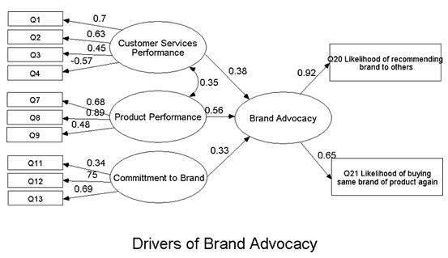
Example SEM Diagram

Slide 4
Factors and components
Factor analysis attempts to achieve parsimony by explaining the maximum amount of common variance in a correlation matrix using the smallest number of explanatory constructs.
These ‘explanatory constructs’ are called factors.
PCA tries to explain the maximum amount of total variance in a correlation matrix.
It does this by transforming the original variables into a set of linear components.

Slide 5
EFA vs PCA
Common variance = overlapping variance between items (systematic variance)
Unique variance = variance only related to that item (error variance)
EFA = describes the common variance
PCA = describes common variance + unique variance

Slide 6
EFA vs PCA
Communality – the common variance for the item
You can think of it as SMC: Squared multiple correlation
Created by using all other items to predict that item

Slide 7
Communality = 1
Variance of
Variable 3
Variance of
Variable 1
Variance of
Variable 2
Communality = 0
Variance of
Variable 4

Slide 8
R-Matrix
In Factor Analysis and PCA we look to reduce the R-matrix into smaller set of dimensions.

Slide 9
EFA vs PCA
EFA factors cause answers on questions
Want to generalize to another sample
PCA questions cause components
Want to just describe this sample
Drawing here
Therefore, EFA is more common in psychology

Slide 10
Uses of EFA/PCA
Understand structure of set of variables
Construct a scale to measure the latent variable
Reduce data set to smaller size that still measures original information

Slide 11
Graphical Representation

Slide 12
Example Data
RAQ – R/Statistics Anxiety Questionnaire
23 Questions covering R and statistics anxiety
Look at the questions!
Be sure to reverse code any items that need it.
Libraries
car, psych, GPArotation

Slide 13
Before you start
Assumptions:
Accuracy, Missing
Outliers
(use Mahalanobis to find outliers for all items)
Linear (!!)
Normal
Homogeneity/Homoscedasticity

Slide 14
Before you start
What about additivity?
You want items to be correlated, that’s the point but not too high cuz then the math gets screwy.
How to check if they are too small:
Bartlett’s Test – if non-significant implies that your items are not correlated enough (bad!).
Not used very much because large samples are required, which usually makes small correlations significant

Slide 15
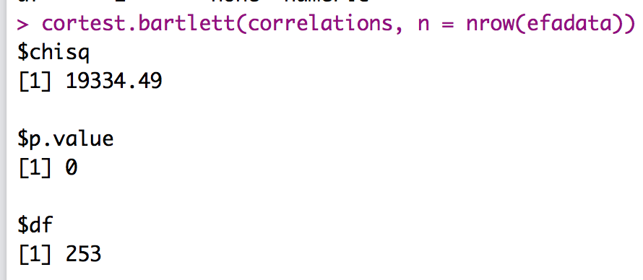
Bartlett’s Test
Load the psych library.
Run and save a correlation test (just like you would for data screening).
cortest.bartlett(correlation table, n = nrow(dataset))

Slide 16
Before you start
Sample size suggestions
10-15 participants per item
<100 is not acceptable
ARGUE LOTS OF MONTE CARLOS!
300 is the most agreed upon best bet

Slide 17
Before you start
Sampling adequacy – do you have a large enough sample?
Kaiser-Meyer-Olkin (KMO) test
Compares the ratio between r² and pr²
Scores closer to 1 are better, closer to 0 are bad
.90+ = yay, .80 = yayish, .70 = ok, .60 = meh, .<.50 = eek!

Slide 18
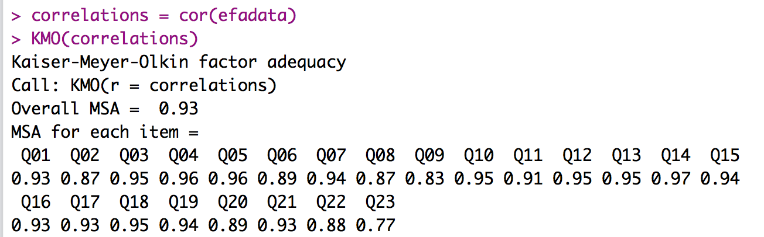
KMO Test
Load the psych library.
Use the saved correlations from the previous step.
KMO(correlation table)

Slide 19
Before you start
Number of items
You need at least 3-4 items per F/C
So with a 10 question scale, you can only have 2 or 3 F/C
The more the better!
Need to be at least interval measurement

Slide 20
Questions to Answer
How many factors/components do I have?
Can I achieve simple structure?
Do I have an adequate solution?

Slide 21
1. # of Factors/Components
Ways to determine number to extract
Theory
Kaiser criterion
Scree Plots
Parallel Analysis

Slide 22
1. # of Factors/Components
Theory
Usually you have an idea of the number of latent constructs you expect
You made the scale that way
Previous research

Slide 23
1. # of Factors/Components
Kaiser criterion
Note this is sometimes still used, but usually not recommended
Old rule: extract the number of eigenvalues over 1
New rule: extract the number of eigenvalues over .7

Slide 24
1. # of Factors/Components
Eigenvalues:
A mathematical representation of the variance accounted for by that grouping of items
Confusing part:
You will see the number of eigenvalues as you have items because they are calculated before extraction
Only a few should be large

Slide 25
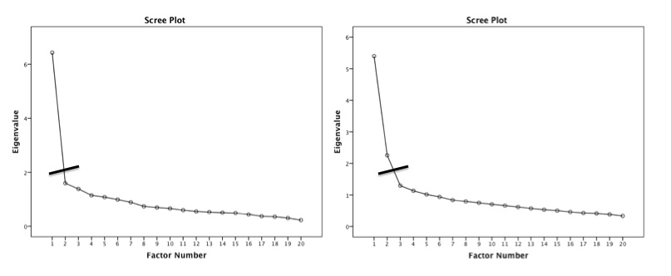
1. # of Factors/Components
Scree plot – a graphical representation of eigenvalues
Look for a large drop

Slide 26
1. # of Factors/Components
Parallel Analysis – a statistical test to tell you how many eigenvalues are greater than chance
Calculates the eigenvalues for your data
Randomizes your data and recalculates the eigenvalues
Then compares them to determine if they are equal

Slide 27
1. # of Factors/Components
What to do if they disagree?
Test both models to determine which works better (steps 2 and 3)
Simpler solutions are better (i.e. less factors)

Slide 28
1. # of Factors/Components
How to run the analysis to get this information:
nofactors = ##save the output
fa.parallel(datasetname, fm="ml", fa="fa")
What is ml and fa? (see step 2)
ML = Maximum Likelihood
FA = factor analysis

Slide 29
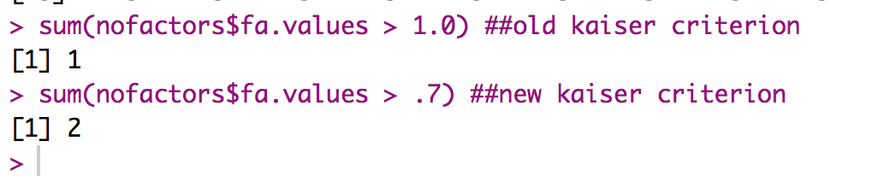
1. # of Factors/Components
Get the eigenvalues
nofactors$fa.values (or sum them up, see r notes)
In this example:
Old criterion says 1 factor
New criterion says 2 factors

Slide 30
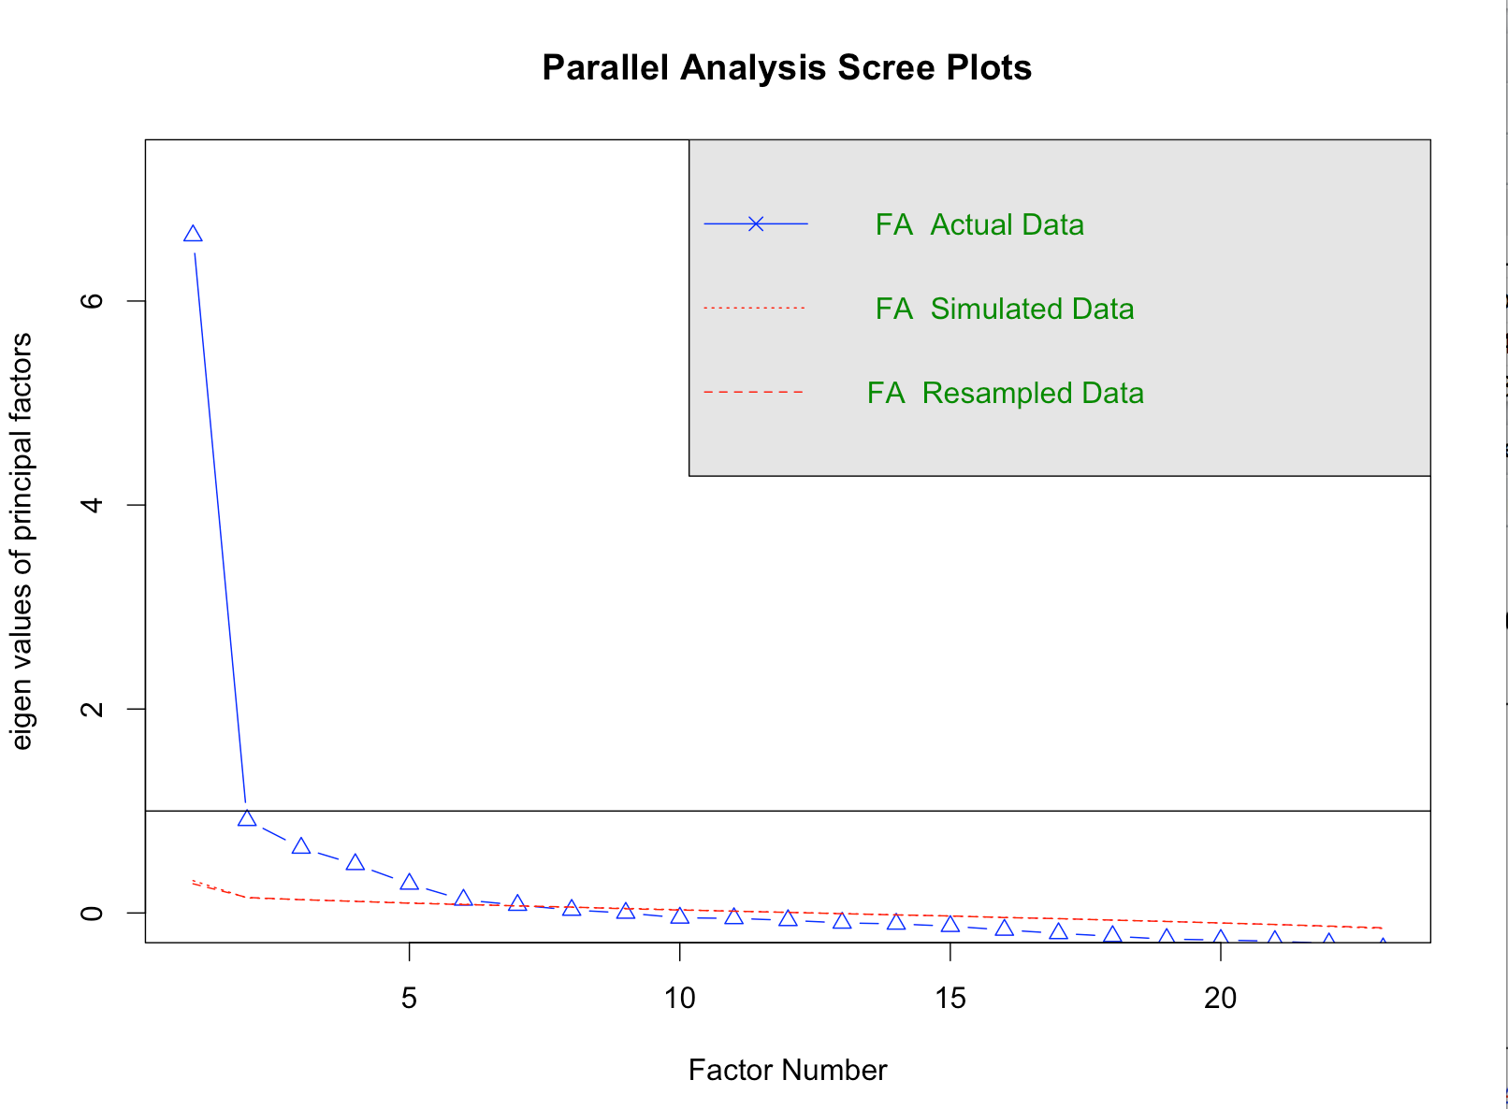
1. # of Factors/Components

Slide 31
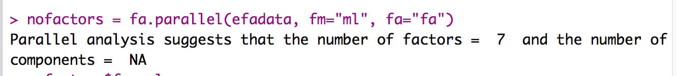
1. # of Factors/Components
Scree plot suggests 1 large factor or 5 factors with the point of inflection.
What about the parallel analysis?
So we have 1 factor (2), 2, 5, or 7

Slide 32
2. Simple Structure
Fitting estimation = MATH that is used to determine factor loadings.
How to pick?
Depends on what your goal is for the analysis.

Slide 33
2. Simple Structure
EFA | PCA
Maximum Likelihood | Principal axis factoring
Alpha factoring | Image factoring
 | Principal components

Slide 34
2. Simple Structure
Rotation – rotation helps you achieve simple structure by increasing the communality between items
To aid interpretation: maximize the loading of an item on one F/C while minimizing its loading on all other F/C
Orthogonal
Oblique

Slide 35
Orthogonal
Oblique

Slide 36
2. Simple Structure
Orthogonal – assumes the F/C are uncorrelated
Rotates at 90º
Means no overlap in variance between F/C
Not suggested for psychology
Types
Varimax, quartermax, equamax

Slide 37
2. Simple Structure
Oblique – assumes some correlation between F/C
Rotates at any degree
Allows F/C to overlap
If F/C are truly uncorrelated, you get the same results as orthogonal
Types
Direct oblimin, promax
So why ever do orthogonal?

Slide 38
2. Simple Structure
Loadings – the correlation between that item and the F/C
What to look for:
Items to load over .300
Remember that r = .3 is a medium effect size that is ~10% variance
You can use higher loadings to help cut out low loading questions, but really can’t go lower.

Slide 39
2. Simple Structure
Loadings
You want each item to load on one and only one F/C
Double loadings = indicate a bad item
No loading = indicate a bad item

Slide 40
2. Simple Structure
Loadings
F/C with only one/two items loading onto it are considered unique
You should consider eliminating that F/C
Remember three or four items are suggested

Slide 41
2. Simple Structure
What to do if bad items?
In this step you might run several rounds
Find the bad items, run the EFA/PCA again without them
Cross loadings?
If there is a good theoretical reason, but generally not accepted

Slide 42
2. Simple Structure
Finished?
When all items have loaded adequately

Slide 43
2. Simple Structure
fa(dataset name, ##dataset
nfactors=2, ##number of factors
rotate = "oblimin", ##rotation type
fm = "ml") ##math type, max likelihood
In reality, you would check several models, but in the interest of time, we are doing two factors.

Slide 44
2. Simple Structure
Start by looking at the loadings.
M1 = factor 1 (organized by variance accounted for – these may switch in the second round)
M2 = factor 2
Want these to be > .300 on ONE item only
H2 = communality (want high)
U2 = uniqueness (want low)
Com = complexity (want low)

Slide 45
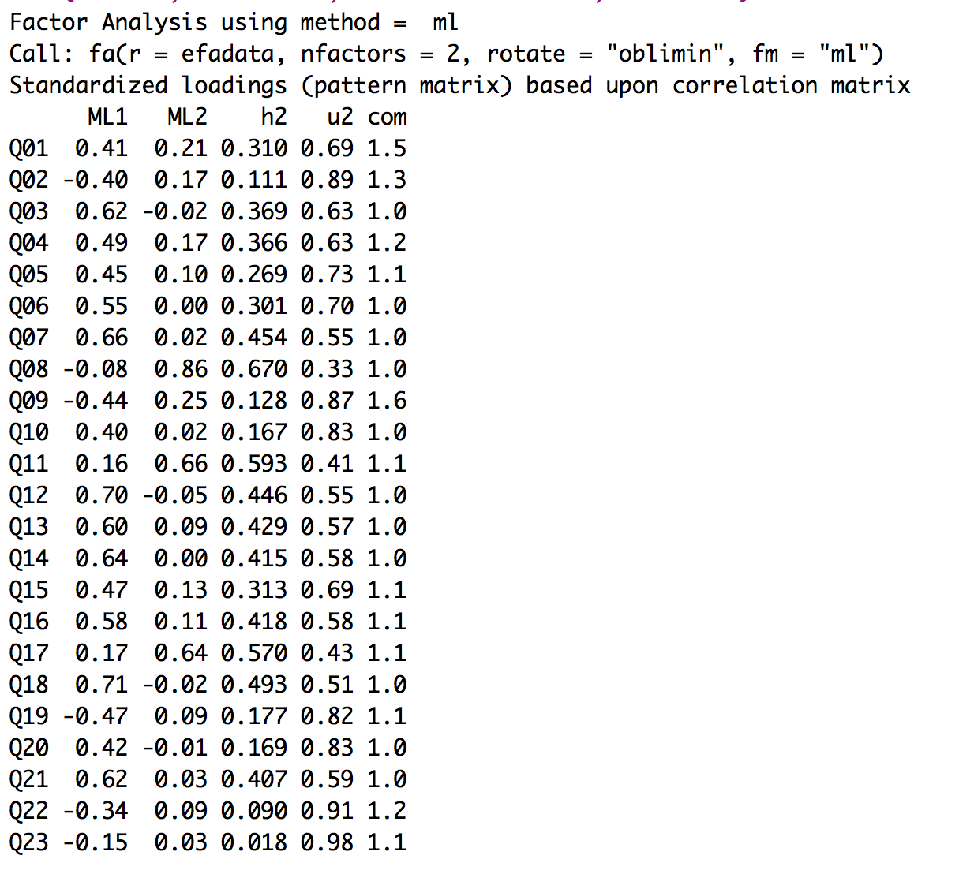
2. Simple Structure

Slide 46
2. Simple Structure
Figure out what items to remove:
Remove 23 because it doesn’t load on either factor.
Run the factor analysis again without that item.
This time all the items load cleanly.

Slide 47
3. Adequate solution
So how can I tell if that simple solution is any good?
Fit indices
Reliability
Theory

Slide 48
3. Adequate solution
Fit indices – a measure of how well the rotated matrix matches the original matrix
Two types:
Goodness of fit
Residual statistics

Slide 49
3. Adequate solution
Goodness of fit statistics – want large values, compares reproduced correlation matrix to real correlation matrix
Fit | Name | Good | Acceptable | Poor
NNFI/TLI | Non-normed fit index, Tucker-Lewis index | >.95 | >.90 | <.90
CFI | Comparative fix index | >.95 | >.90 | <.90
NFI | Normed fit index | >.95 | >.90 | <.90
GFI, AGFI = don’t use

Slide 50
3. Adequate solution
Residual statistics – want small values, look at the residual matrix (i.e. reproduced – real correlation table)
Fit | Name | Good | Acceptable | Poor
RMSEA | Root mean square error of approximation | <.06 | .06-.08 | >.10
RMSR | Root mean square of the residual | <.06 | .06-.08 | >.10

Slide 51
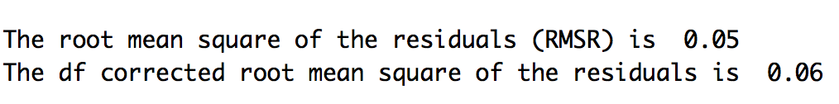
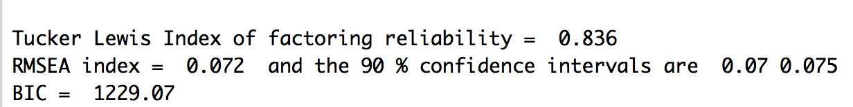
3. Adequate solution
RMSR and RMSEA check out ok!
The TLI is bad ☹.
What about CFI?

Slide 52
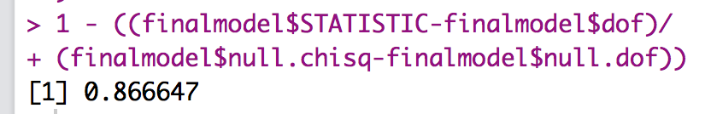
3. Adequate solution
CFI formula =
(chi square model – df model) / (chi square null – df null)
Use the code! You will have to save the output first.
Note all this information is in the basic output, but it’s not the easiest to read.

Slide 53
3. Adequate solution
Reliability – an estimate of how much your items “hang together” and might replicate
Cronbach’s alpha most common
.70 or .80 is acceptable
Split-half reliability for big datasets
Splits data in half, runs reliabilities, checks how similar they are

Slide 54
Interpreting Cronbach’s Alpha
Kline (1999)
Reliable if α > .7
Depends on the number of items
More questions = bigger α
Treat Subscales separately
Remember to reverse score reverse phrased items!
If not, α is reduced and can even be negative

Slide 55
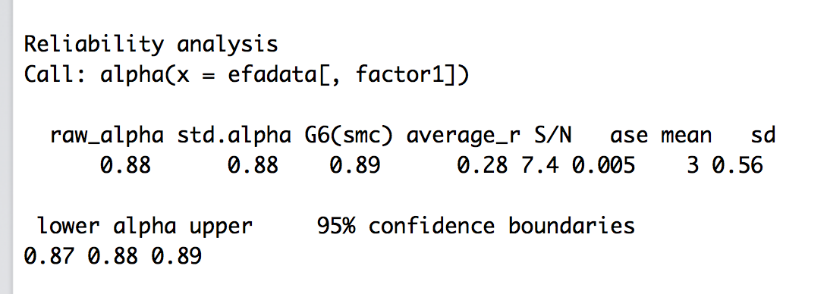
3. Adequate solution
Cronbach’s:
alpha(dataset with only columns for that subscale)

Slide 56
3. Adequate solution
Theory
Do the item loadings make any sense?
Can you label the F/C?
Look at how they load and see if you can come up with a label for the F/C.

